Slide 1

Analytical Study of Company Sales in the U.K.
Jontavius Caston & Dianna Sinicrope
February 27, 2020
Notes:
,

Slide 2
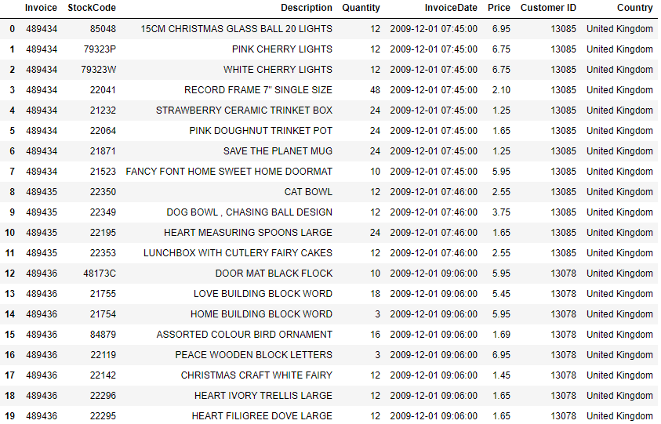
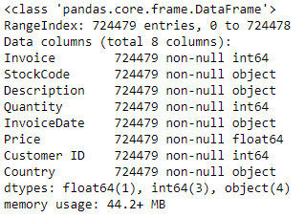
The Data
We chose this dataset because it looked like it had a lot of unknowns for us to unlock.
We could see that there was what appeared to be plenty of data for us to work with.
The data had a little of everything for us to experiment from numbers, to dates, to text and the analysis seemed as if it were limitless.

Slide 3
In 2011…
$6.8M sales
15K transactions
3,735 unique products sold
3,809 customers
Notes:
Probably need a visualization here. Pyramid of some sort? Something else? Not sure. Maybe use this as # of products sold, # transactions, $ sales in 2011. And then in next slide go into projections and start raising the red flag of decreasing sales projections.

Slide 4
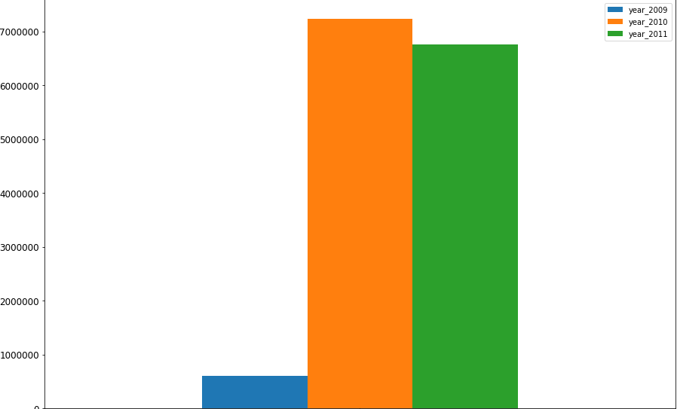
Decrease in Revenue
Sales have decreased in the last year.
2010 Sales
2011 Sales
$7.2M
$6.8M
Chart created in matplotlib

Slide 5
-7% YOY
Decrease in Revenue
Sales have decreased in the last year.
2010 Sales
2011 Sales
$7.2M
$6.8M
Chart created in matplotlib

Slide 6
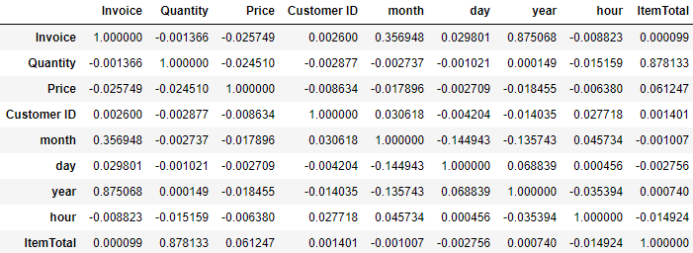
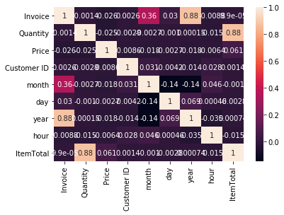
Correlations
These are the correlation matrices from original cleaned dataset.
There is very little correlation seen here between the different variables.
There were no significant correlations that we did not see from looking at the dataset initially.
As we mentioned on a previous slide, our next step is to look at calculated metrics like frequency and recency and whether they have the ability to cause revenue increases.
$6 BILLIONS
$4 BILLIONS
Notes:
JC- where to go with this one?
I still feel like Correlations are important just not quite sure how to work them in yet. Need to investigate further. What levers can we pull to affect sales in certain product or customer segments?
Here is the correlation that we currently have. I attached both graphs so we can see which would work better for us. There is still nothing really crazy sticking out here...yet.

Slide 7
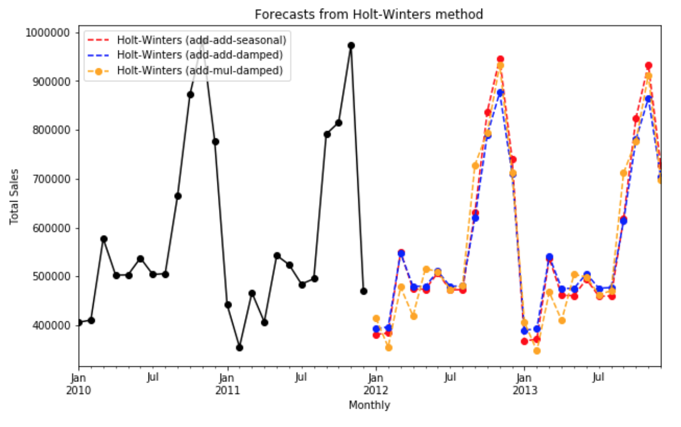
Monthly Sales Projections
$6 BILLIONS
$4 BILLIONS
Notes:
DS

Slide 8
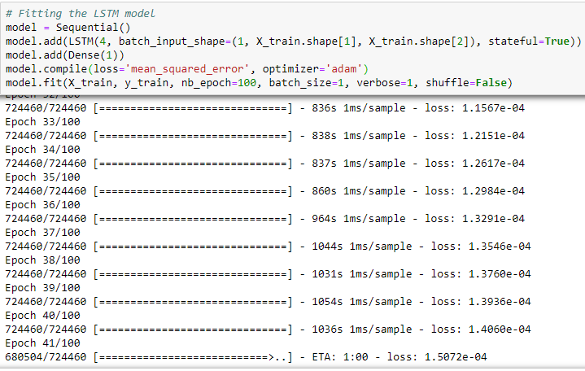
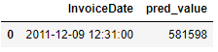
Deep Learning Sales Prediction
The Long Short-term Memory (LSTM) method was used to perform this analysis.
This method is a very time intensive.
The new predicted value that we got is $581K.
$6 BILLIONS
$4 BILLIONS
Notes:
JC- want to say something about this one or should we take it out?

Slide 9
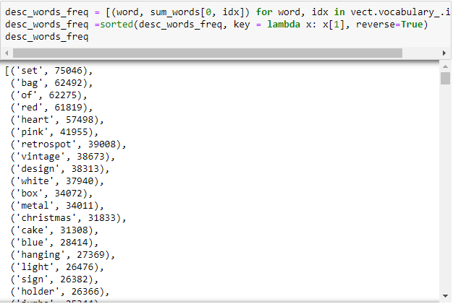
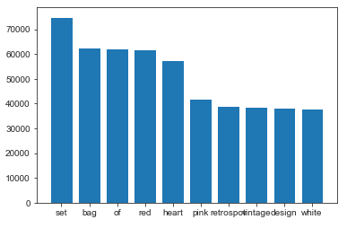
Product Analysis
Text clustering has been one of the more difficult task for us thus far.
We decided to use bag of words in order to tackle NLP for our product descriptions.
Our next step here will be to eliminate useless words so that we see more items and not item descriptions. Our product description text is rather short, so we plan to isolating adjectives and nouns as a next step.
$6 BILLIONS
$4 BILLIONS
Notes:
JC- want to say something about this one or should we take it out?

Slide 10
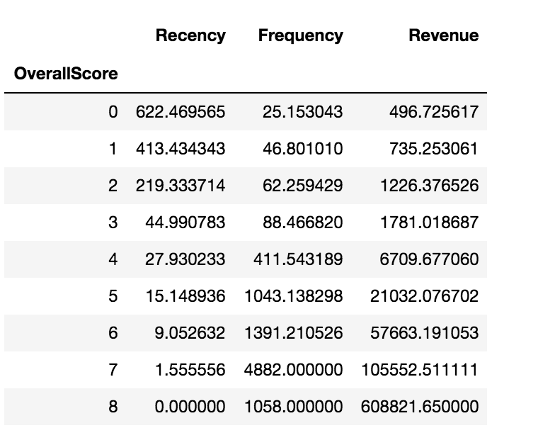
Customer Analysis & Segmentation
Using k-means, we segmented customer groups based on recency, frequency, and money spent.
Each customer was assigned a value score (high, medium, or low value) based on our model.
Our goal for this segmentation is to identify customer segments ripe for development. Whether that means that we need to develop marketing plans to transform a percentage of low-value users to the medium-value group, or if we need offer discounts to increase revenue from high-value users, we think this is a good start as to the insights that will drive our future marketing strategies.
$6 BILLIONS
$4 BILLIONS
Notes:
DS
“RFM (Recency, Frequency, Monetary) analysis is a behavior-based approach grouping customers into segments. ”
https://www.datacamp.com/community/tutorials/introduction-customer-segmentation-python
Behavioral segmentation. DS working on this- Clustering of customers- what do they all have in common? Which customer segments re ripe for improvement/ improved sales? Which customers do we need to spend more time on and which customers are we not seeing ROI on?

Slide 11
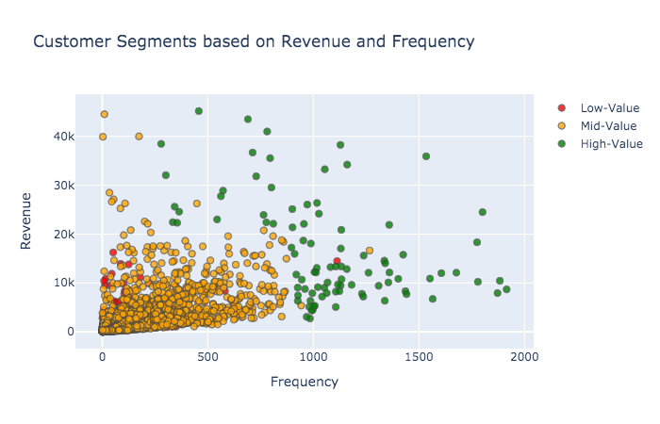
Customer Analysis & Segmentation
We plotted our customer segments, which can be seen on the following three slides.
This is our most promising outcome of potential customer groups to target for increasing product sales.
$6 BILLIONS
$4 BILLIONS

Slide 12
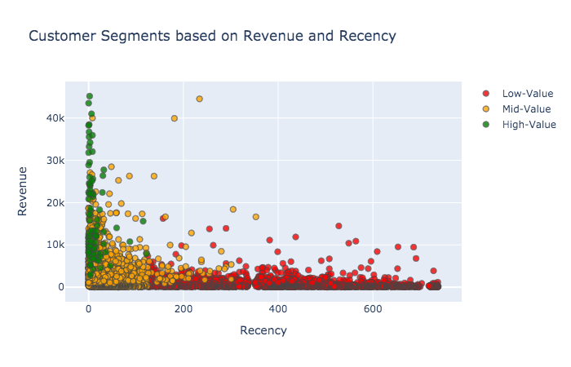
Customer Analysis & Segmentation
Outliers might be perfect examples of customers we should target. For example, the two mid-value customers that spent around $40K but haven’t returned to us in 200 days- how can we get them to return to the site and spend more money?
$6 BILLIONS
$4 BILLIONS

Slide 13
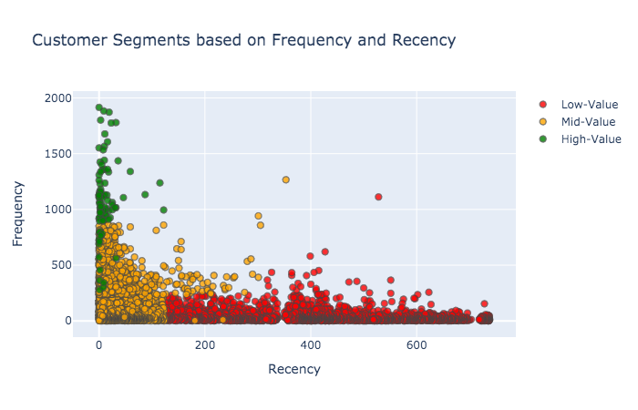
Customer Analysis & Segmentation
This chart is probably the least insightful chart that we have for revenue since it only tracks frequency and recency.
Could be beneficial when considering customer engagement.
$6 BILLIONS
$4 BILLIONS

Slide 14
Recommendations

Slide 15
Recommendations
_{Customer Segmentation is Key}
Email Marketing
Social Media Branding
Customer Segment Movements
Increase SEO
Incentive Programs
Free shipping on orders over $x.
Discounts on order over $x.
BOGO programs
Customer loyalty & points programs.
We already have all of our customers’ email addresses. Let’s utilize email as a new customer touchpoint.
Email marketing also complements our customer incentive program.
Branding strategy, as well as an open line of communication with our customers.
Serves as a digital way to attract new online customers.
Closely monitor customers who shift from one segment to another. Play defense for customers who downshift, and offer more incentives for those who move up a segment.
Route new customers to the website with better SEO practices.
Compete with Amazon OR sell on Amazon to get our products in front of a bigger customer base.

Slide 16
JON CASTON
J.Caston91@gmail.com
CONTACT US
DIANNA SINICROPE
diannasinicrope@gmail.com

